Slide 1
Chapter 12: introduction to strategy trees

Slide 2
Contents
Introduction
Strategy Trees
Treatments
Extensions
Demo
Building a Strategy Tree on an existing Decision Tree
Building a Strategy Tree on a dataset

Slide 3
Introduction to Strategy Trees
Leveraging models traditionally is a matter of:
Scoring data
Adding additional measures, such as KPIs
Using external products, e.g. excel, to slice and dice
Assess how best to proceed and treat records/segments
Knowledge Studio provides the facility to:
Augment model scores with additional measures
Assign treatments using a process feature called a Strategy Tree
Notes:
Let me tell you whet they’re used for.
Traditionally when you want to use your model and make decision base on result of your model – not just looking at predictions – yes and no’s- you are actually building a complicated decision and more like building a strategy based on your model- you are gonna score some data from a generally large database and then you’re going to add additional measures.
So it’s not just the probabilities and predictions; you are gonna looking at other measures too, like the profitability of certain group, how much money you are making, things like that.
We often call those KPIs (Key Performance Indicators). And then you would often take the results and use external products such as excel and do what’s we usually call slicing and dicing to assess how best to proceed.
You’re gonna break up your data into bunch of different groups and you say well I sort of have some feeling about this group over here and then you are gonna make a decision about them.
That can be a bit cumbersome and it will also take us a bit away from the point of analytics which is to make data based decisions.
So instead, Knowledge Studio provides the facility to augment model scores with additional measures and to assign treatments directly within the tree. This is an extension to what we call decision tree. Not just the decision tree. because It’s more than a model. It’s really a strategy tree. It’s a tree where we are keeping track of information but it’s not just the data , we’re also keeping track of strategies and KPIs.

Slide 4
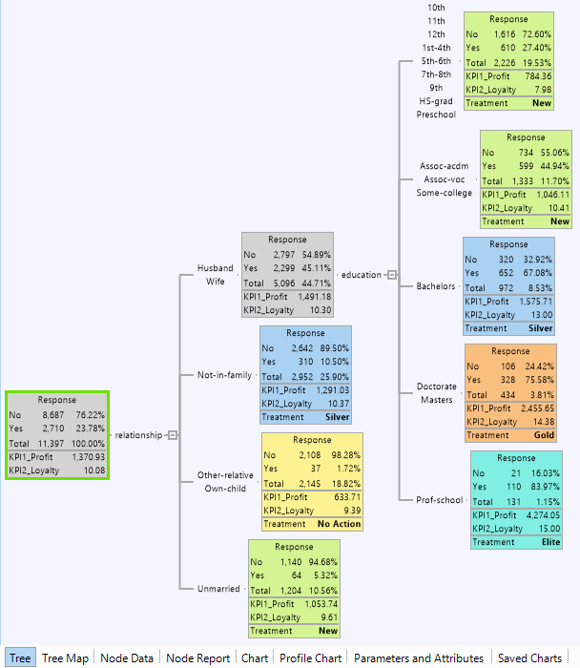
Strategy Trees
Patented
Can be built on a dataset or an existing Decision Tree
Strategy Tree extends Decision Tree functionality
Decision Trees segment data
Strategy Tree:
Adds additional measures
Applies a treatment
Treatments : actions
Based on segment characteristics & business goals
Notes:
There are 2 different ways to build a strategy tree in KS…
We distinguish decision tree from strategy tree easily. By default, DT orientation is top-down where strategy tree orientation is left to right. You see this strategy tree goes from left to right. You can change the orientation to top-down from the preferences menu.
Ok what are we seeing in the ST? One thing you might notice is that I’ve got dependent variable listed on top of all nodes. This is important because in strategy tree you are actually able to change the dependent variable at different splits. You might do one split on one dependent variable, and another split based on another dependent variable. So its going to keep track of what your dependent variables are.
Also we’ve still got the ‘Yes’, ‘No’ and ‘Total’ that we have in our decision tree, but you also see couple other things below it. We’ve got KPIs- you might have a key performance indicator for ‘Profitability’. So this might give you the average ‘profitability’ in each node / group.
Then you also have a treatment. So you can say some of these people are high in profitability so I am going to offer them the ‘Silver’ card. And the other people in the green node are lower in profitability so I don’t offer them any card. So you have different strategy or treatment assigned to the nodes.
One other difference is that the coloring of the nodes. So for example in this ST we’ve colored nodes base on the treatment. So you can assign different colors to different treatments so it gives you a visual clue. Which nodes correspond to which treatment.

Slide 5
Strategy Trees differentiators
Strategy Trees allow
More flexible segmentation:
Segmentation without a Dependent Variable
Use of multiple Dependent Variables
Monitoring of key metrics throughout your segmentation
Add calculations at the node level
Examples: averages, totals, indexes, percentages
Assign treatments for final business actions
Strategy validation

Slide 6
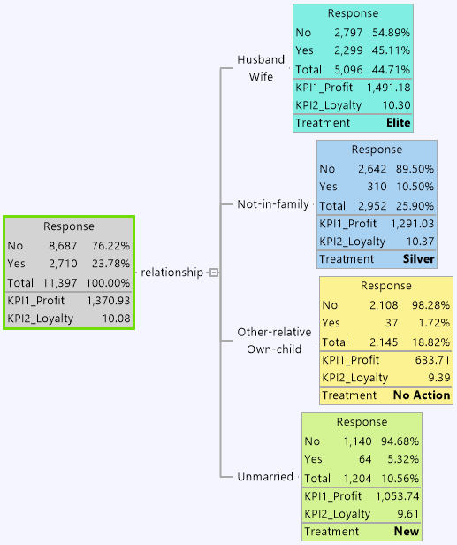
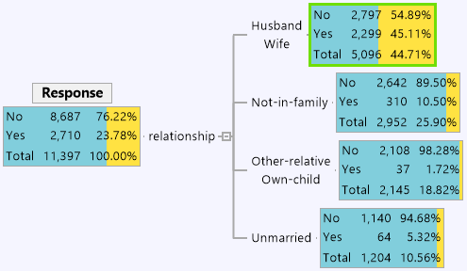
Decision Trees vs. Strategy Trees

Slide 7
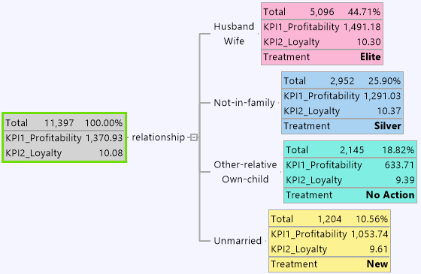
Split without a DV
Tree can be split with or without a DV

Slide 8
KPIs
Key performance indicators such as total profit, average spend, bad debt percentages etc., that are driven by the business objectives
Assist in determining which actions will be assigned for each node or segment of your target population
May be used for estimating the benefit of the strategy (ROI)

Slide 9
A Marketing Example
Marketing Mailer
For an upcoming marketing campaign, a marketing team will be sending e-mail and regular mailers. However, they only want to send mailers to customers that are most likely to respond to the campaign and provide the greatest profit.
Solution
Use Strategy Trees to identify segments of the population that is most likely to respond. For each segment assess the average profit that can be gained, and the loyalty of those customers. Based on likelihood to respond and profit and loyalty of each segment, decide whether a segment receives a mailer or an e-mail.
Demo

Slide 10
Chapter 12 Exercises
Locate or create a Decision Tree for the Census dataset
Prior to creating a Strategy Tree, simplify the Decision Tree model (suggestion at most 2 layers deep). Create an instance of the new Decision Tree
Flip the model horizontally from the View menu select Horizontal Tree
Use the Model Instance and the same dataset used to train the model to create a Strategy Tree
Add some KPIs:
Create KPI1 – Profitability; Use the Average Aggregate function and the variable capital_gain
Create KPI2 – Loyalty; Use the Average Aggregate function and the variable num_products
Assess the overall averages for each KPI at the root node
Compare the KPIs at each node to the average KPIs and overall response rate to assess which records are of most interest
Create and assign some treatments using the pill icon on the task bar
Using the Options button apply colors to the Strategy Tree based on Treatments
If time permits: Build a Strategy Tree based on a dataset (from scratch)

